Slide 1
Capstone project Presentation

Slide 2
DOCKER Jira Prometheus

Slide 3
GROUP 2
ASHNA T P
HEMANTH
ANAGHA MOHAN
JESWIN ROY
KIRAN XAVIER

Slide 4

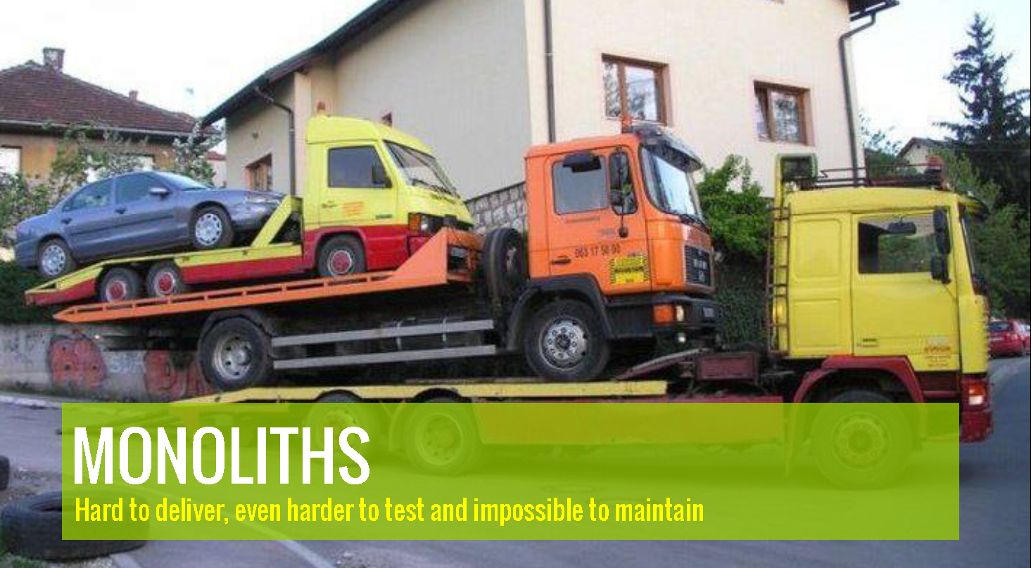
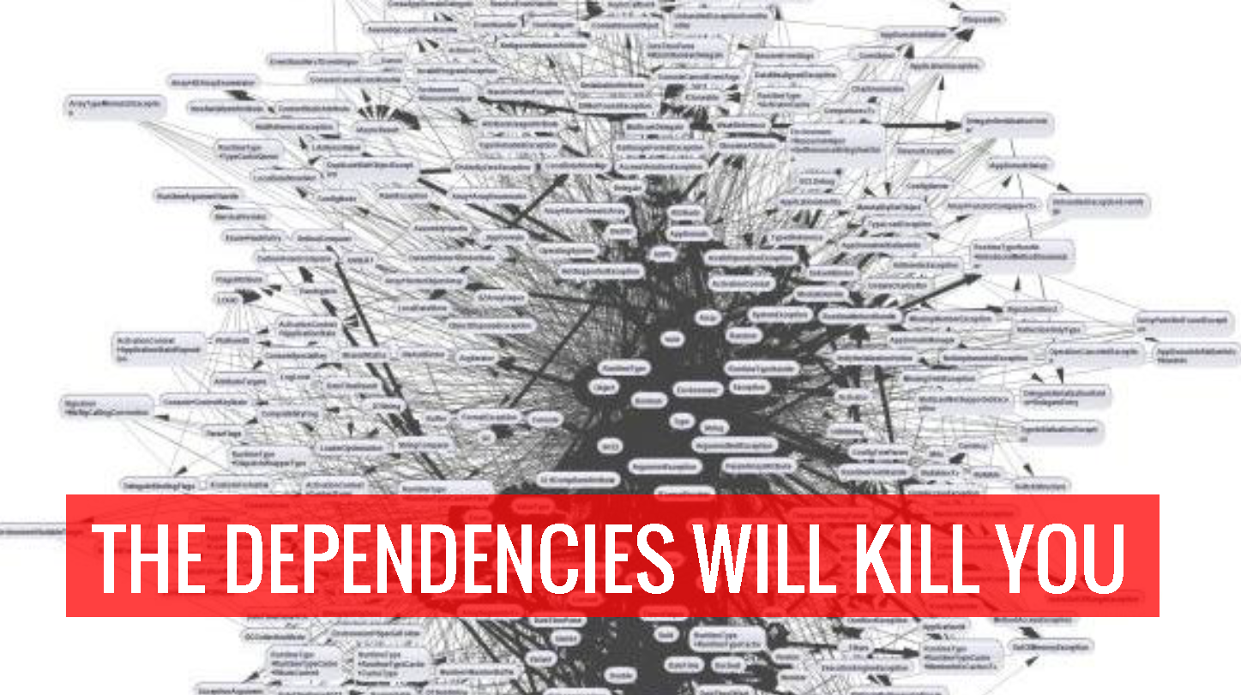
1.
Docker - Build, ship and run

Slide 5

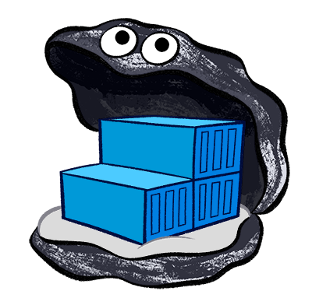

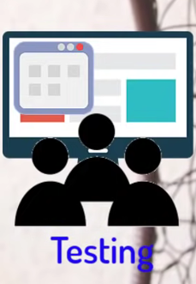
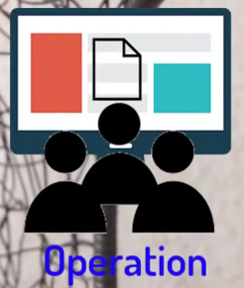
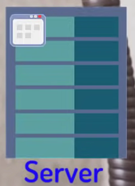
It is an ecosystem
What a Docker image or container consists of ???
Frameworks
Application
Dependencies & Libraries

Slide 6
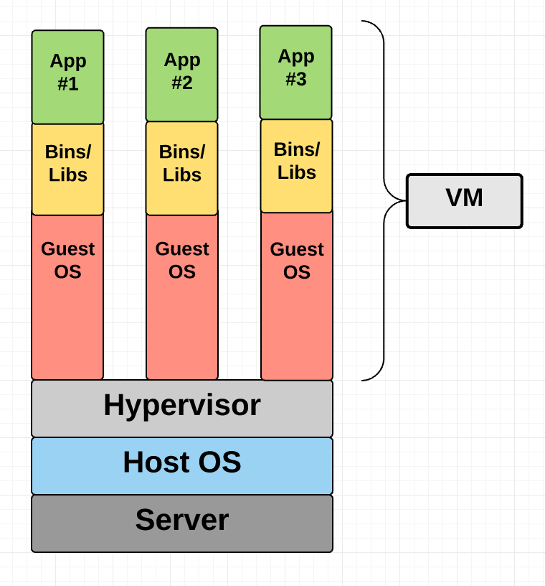
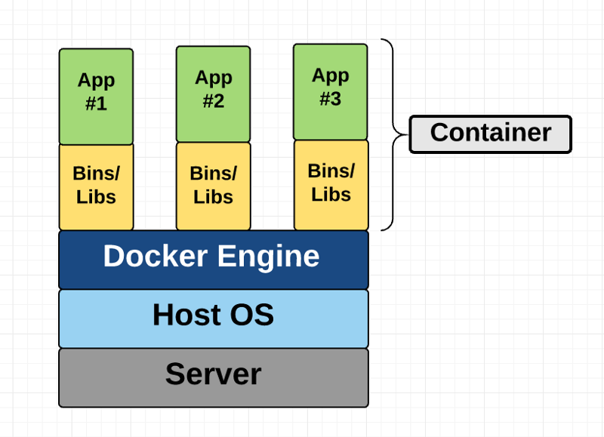
V
VM vs Docker
Huge size, Slow performance and Hard to integrate
Small in size, Quick performance and Easy to integrate

Slide 7
Docker
Ease of use. It allows anyone to package an application on their laptop, which in turn can run unmodified anywhere
The mantra is: “build once, run anywhere.”
Speed. Docker containers are very lightweight, they take up fewer resources
Docker Hub. Docker users also benefit from the increasingly rich ecosystem of Docker Hub, which you can think of as an “app store for Docker images
Modularity and Scalability. Docker makes it easy to break out your application’s functionality into individual containers. With Docker, it’s become easier to link containers together to create your application, making it easy to scale or update components independently in the future.

Slide 8
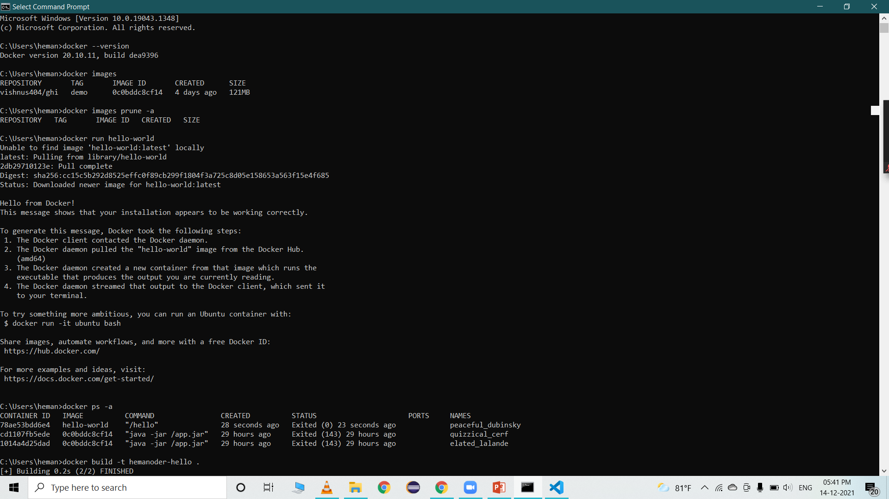
Docker Installation
1)Follow this link to download Docker for windows: https://www.docker.com/products/docker-desktop
2) Post successful installation, Launch command promnt(cmd) in your machine

Slide 9
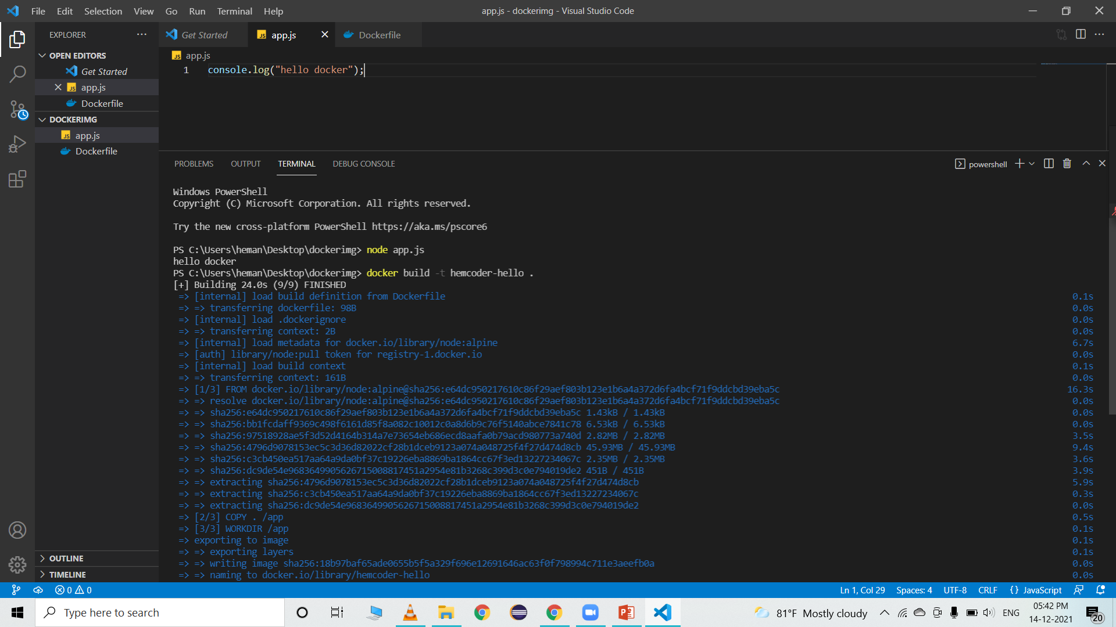
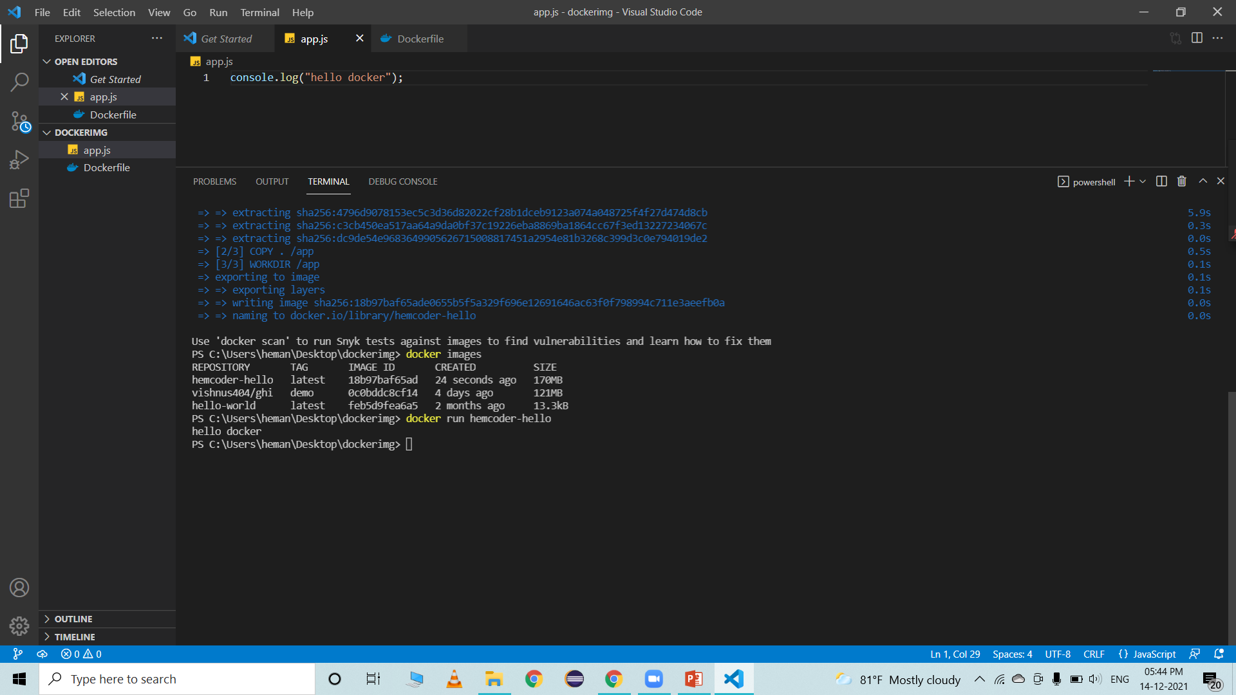
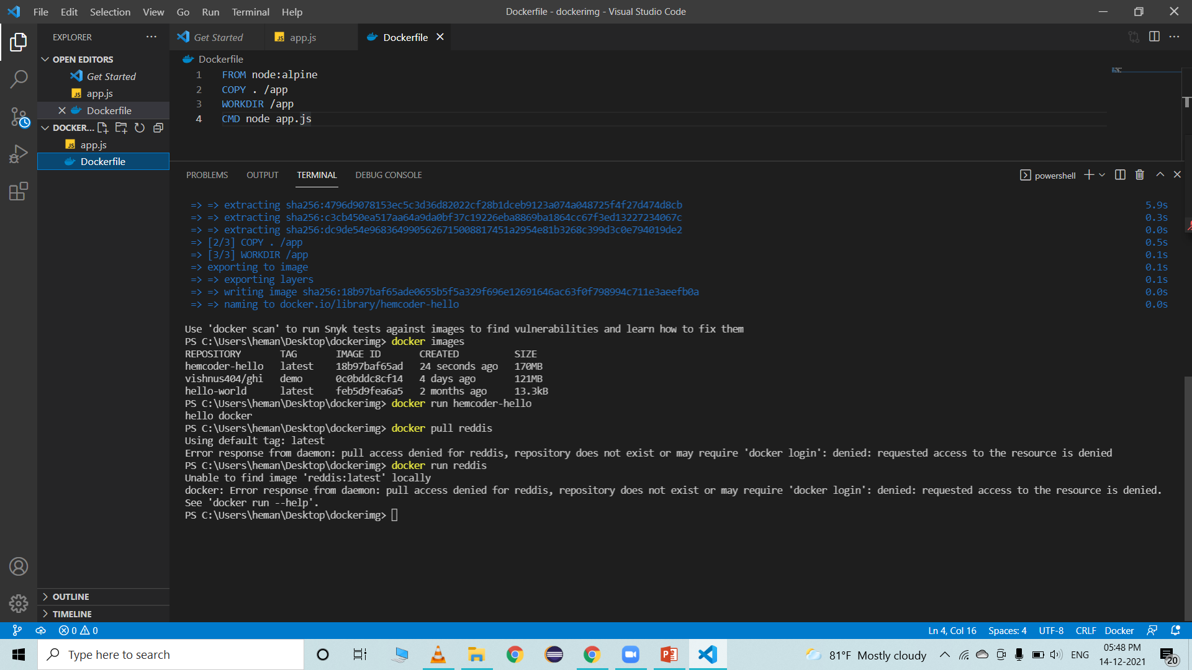
Next steps:
Push that created image to docker hub
Pull that image to local
Build a container for it and run

Slide 10

2.
Jira

Slide 11
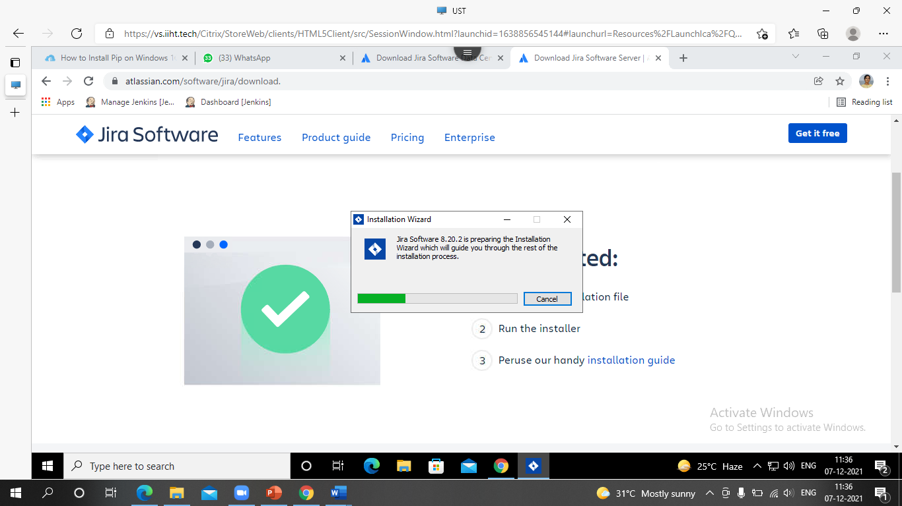
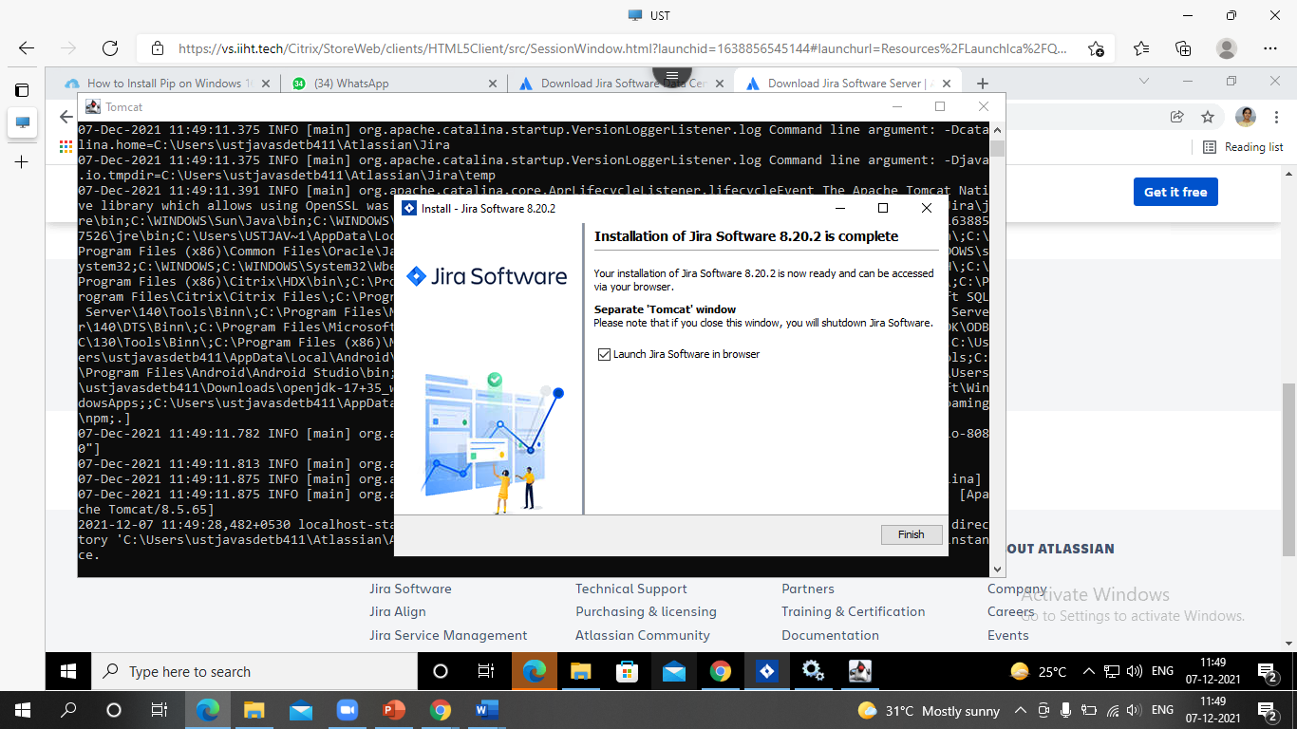
Software application used for issue tracking and project management.
Developed by the Australian software company Atlassian.
Widely used by agile development teams to track bugs, stories, epics, and other tasks.
Pure java based application and supports all OS
JIRA Installation
Take the following link to install JIRA https://www.atlassian.com/software/jira/download.

Slide 12
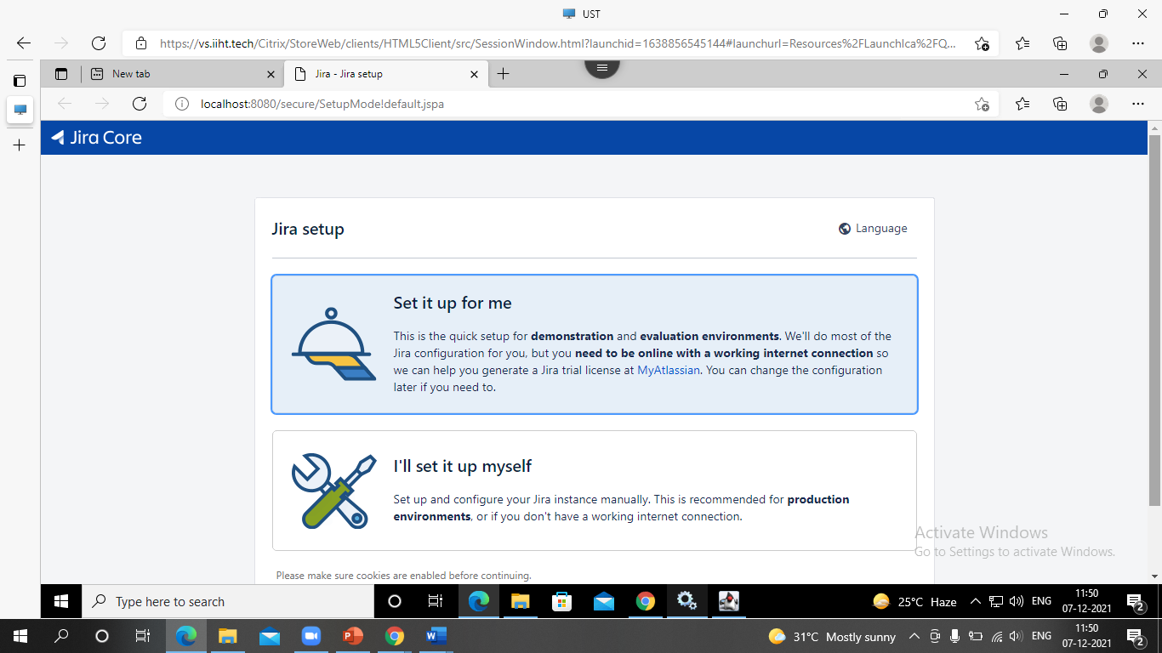
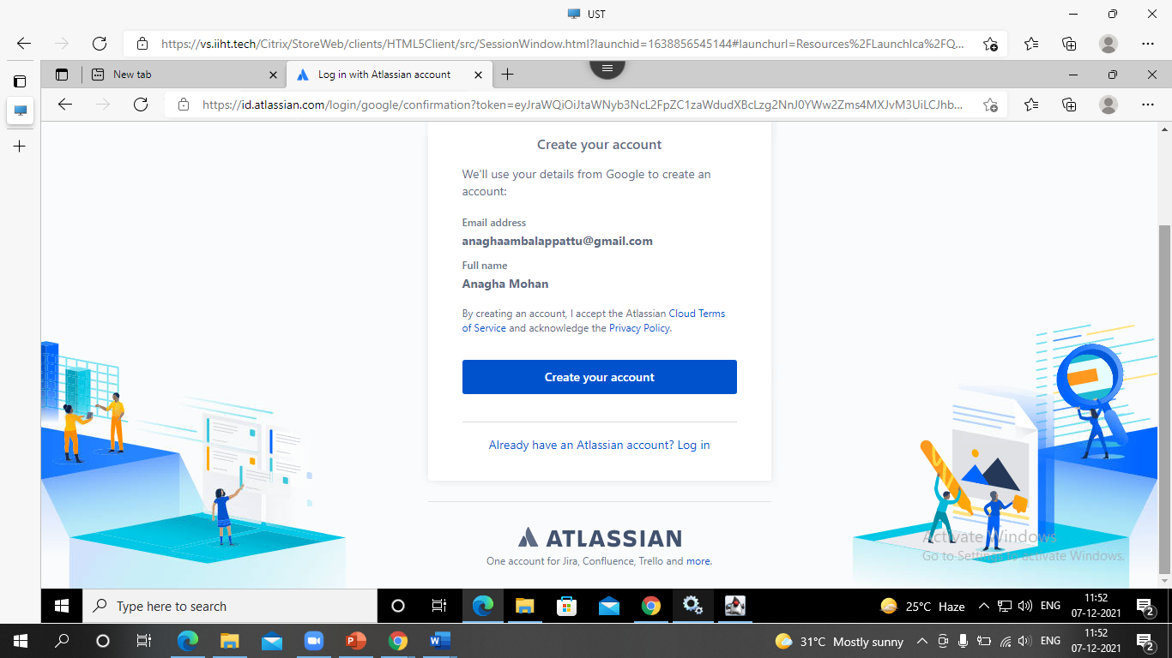
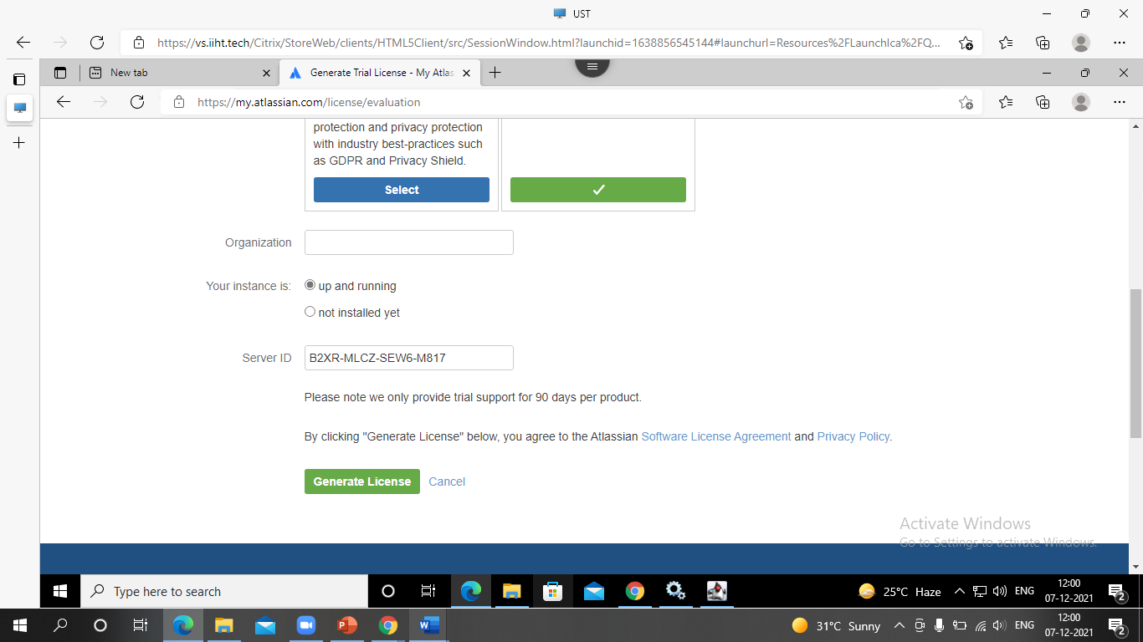
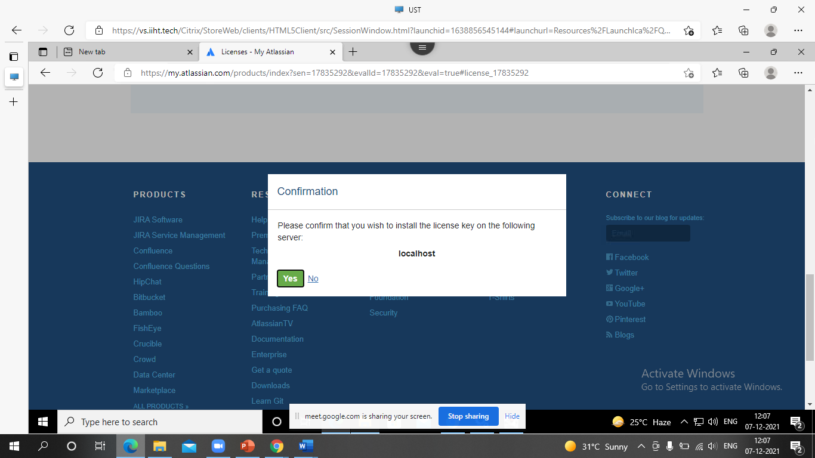
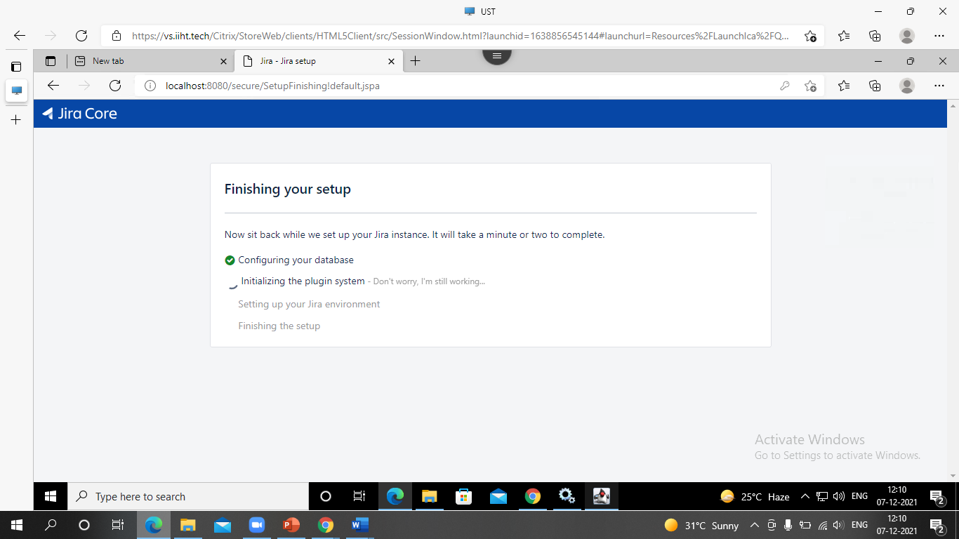
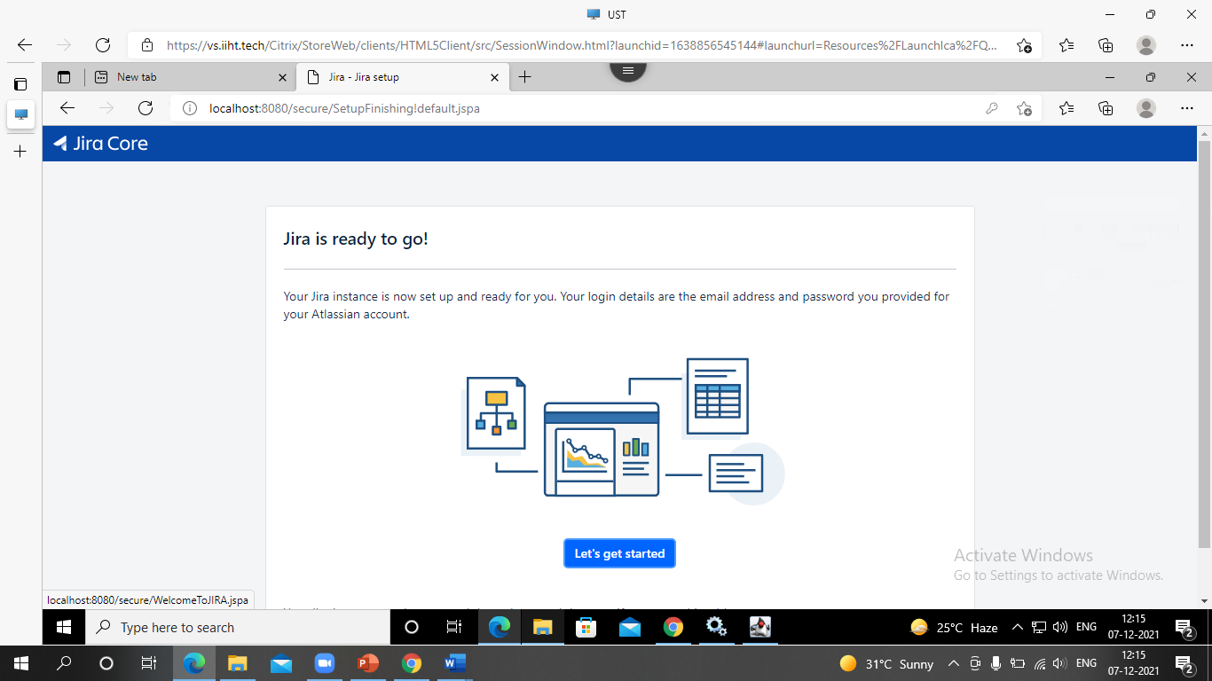
JIRA setup
Create an account
Generate License
Confirm to install the license key
Setup in progress
Jira is ready to use now

Slide 13
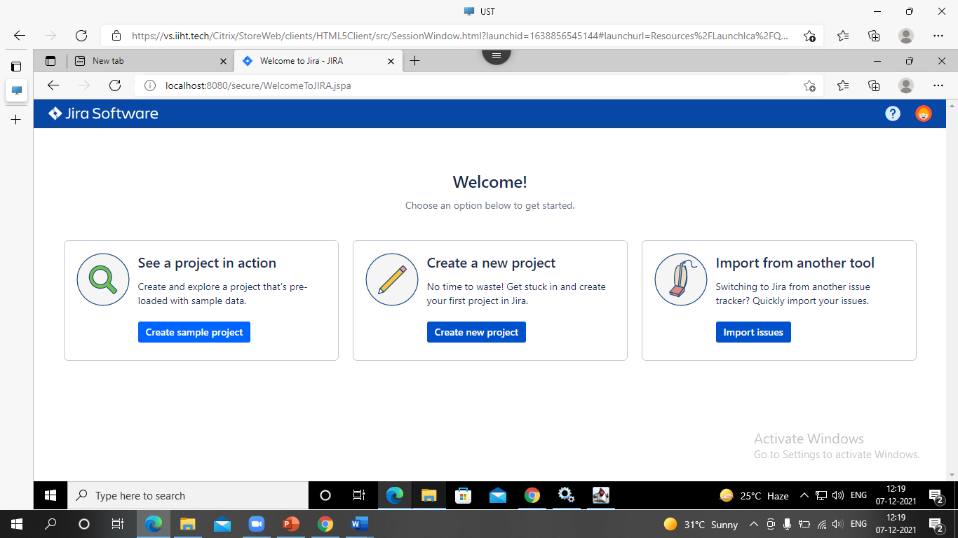
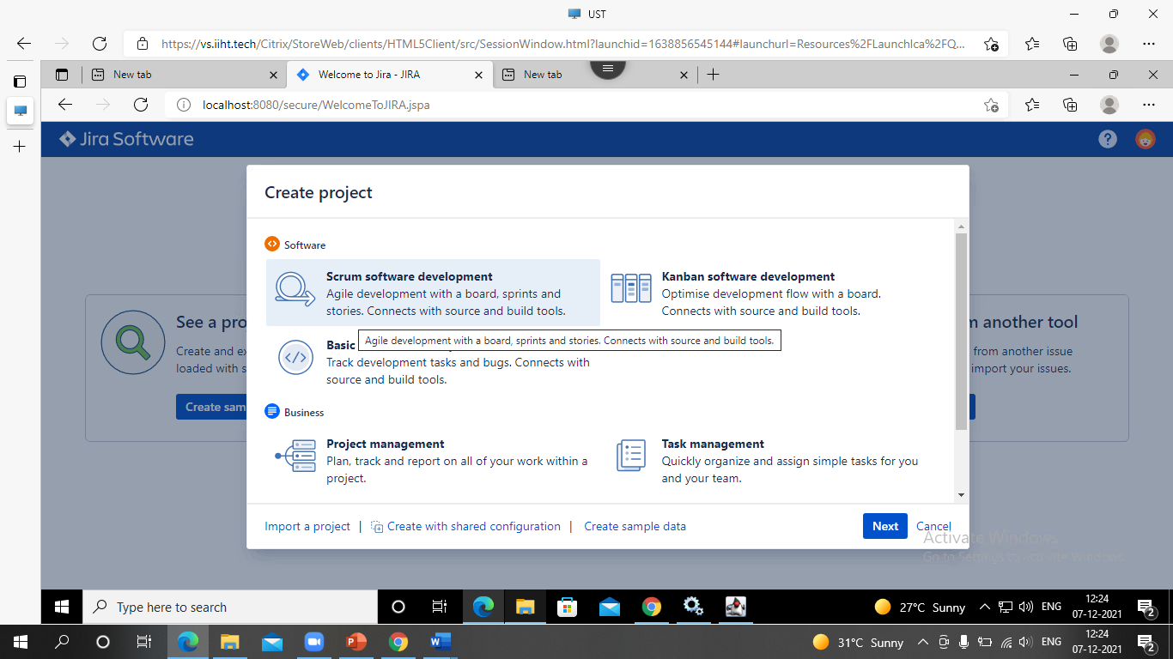
JIRA project
Collection of issues
Types:
Software development project
Marketing project
Help desk tracking project
Leave request management project
Employee performance system

Slide 14
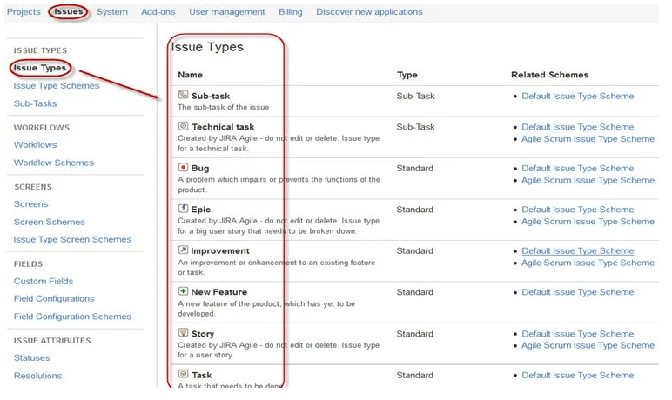
JIRA ISSUES
Track bug or issue that underlies the project.
Displays all type of items that can be created &
tracked via JIRA testing tool
An issue can be dependent on the organization and requirements.

Slide 15
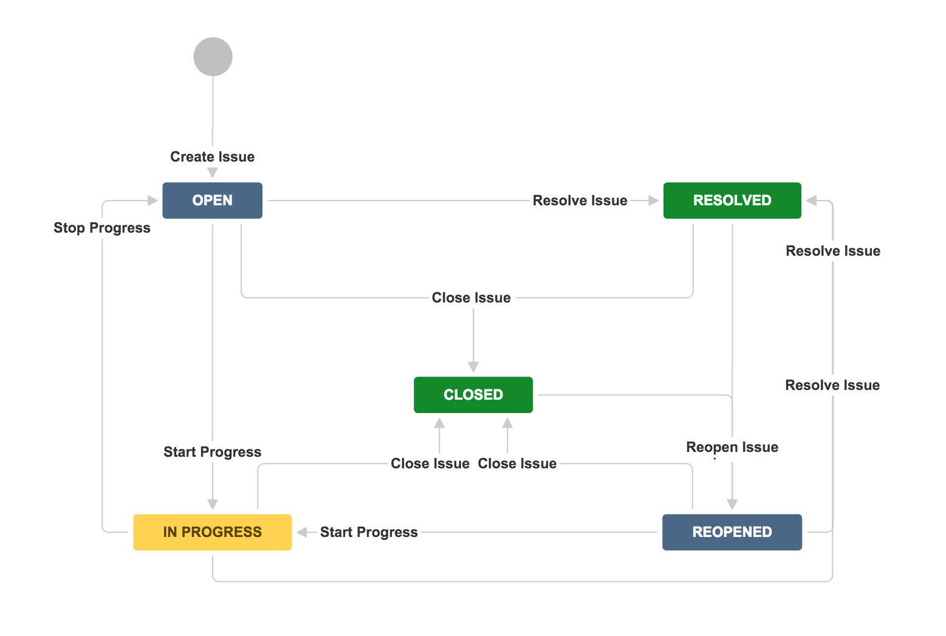
JIRA Workflow
Set of statuses and transitions that an issue goes
through during its life cycle.
Main stages
Open Issue
Resolved Issue
InProgress Issue
ReOpened Issue
Close Issue

Slide 16
Boards
Multilingual
Notifications
CORE
Scale with Team Growth
Reports
FEATURES OF
JIRA
Task Details
Power Search

Slide 17

3. Prometheus

Slide 18
INTRODUCTION
Open Source monitoring and alerting system
Alerting rules can be created within Prometheus and configure to send custom alerts to Alert manager.
Metrics-based time series database, designed for white-box monitoring.
Most Prometheus components are written in Go (Some are also written in Java, Python, and Ruby).
Go is a statically typed, compiled programming language designed at Google
Prometheus is a monitoring and alerting tool which works along with Grafana

Slide 19
FEATURES
Dimensional data
Powerful queries
Great visualisation
Efficient storage
Simple operation
Precise alerting
Many client libraries
Many integrations

Slide 20

CONTINUOUS MONITORING- PROMETHEUS
Application Exception
Memory Usage
Server CPU
Storage Spikes

Slide 21
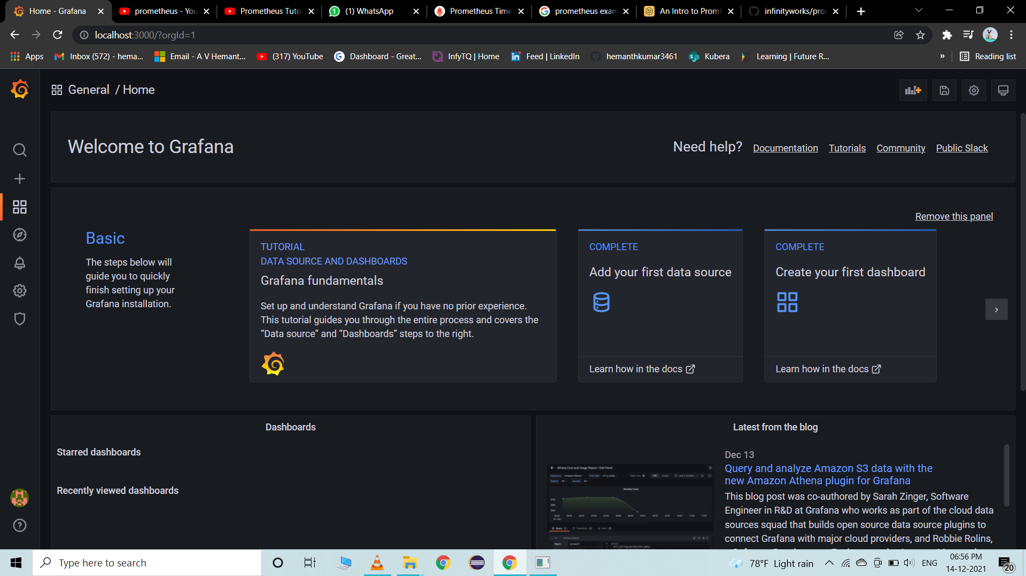
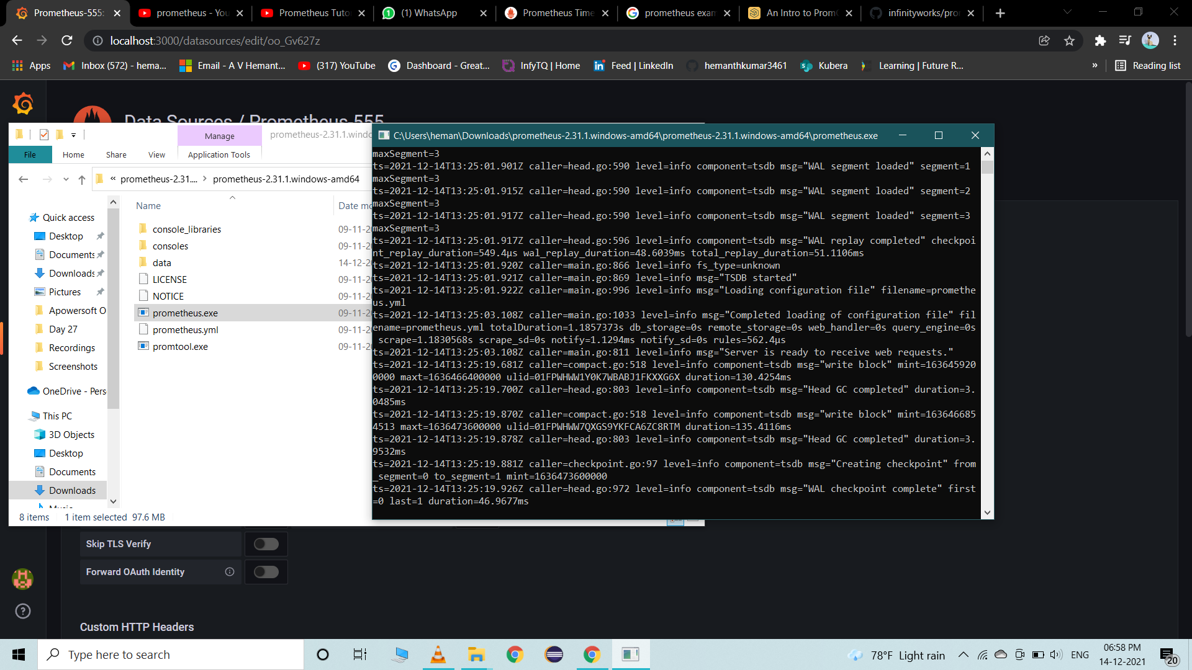
Setting up Prometheus
First launch grafana at port 3000.
Download Prometheus from the following link: https://prometheus.io/download/
Post downloading, open and launch the exe file
Go and verify Prometheus in port 9090(localhost:9090)
Setting up environment is completely
Take a sample Promql query and paste in Prometheus
Click on run and observe the metrics in the form of tables and graphs
This can be used for various applications for monitoring and alerting purposes

Slide 22
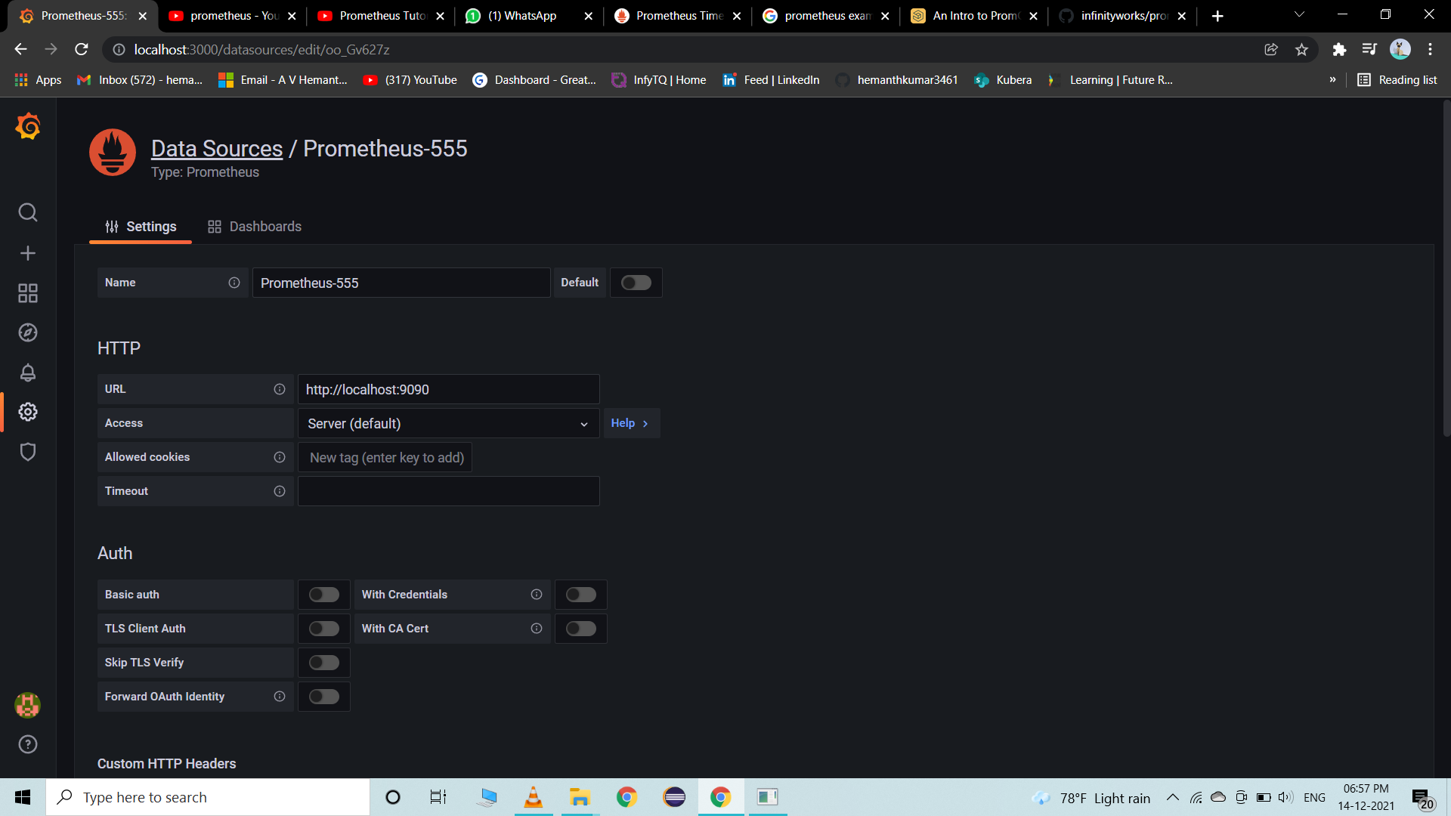
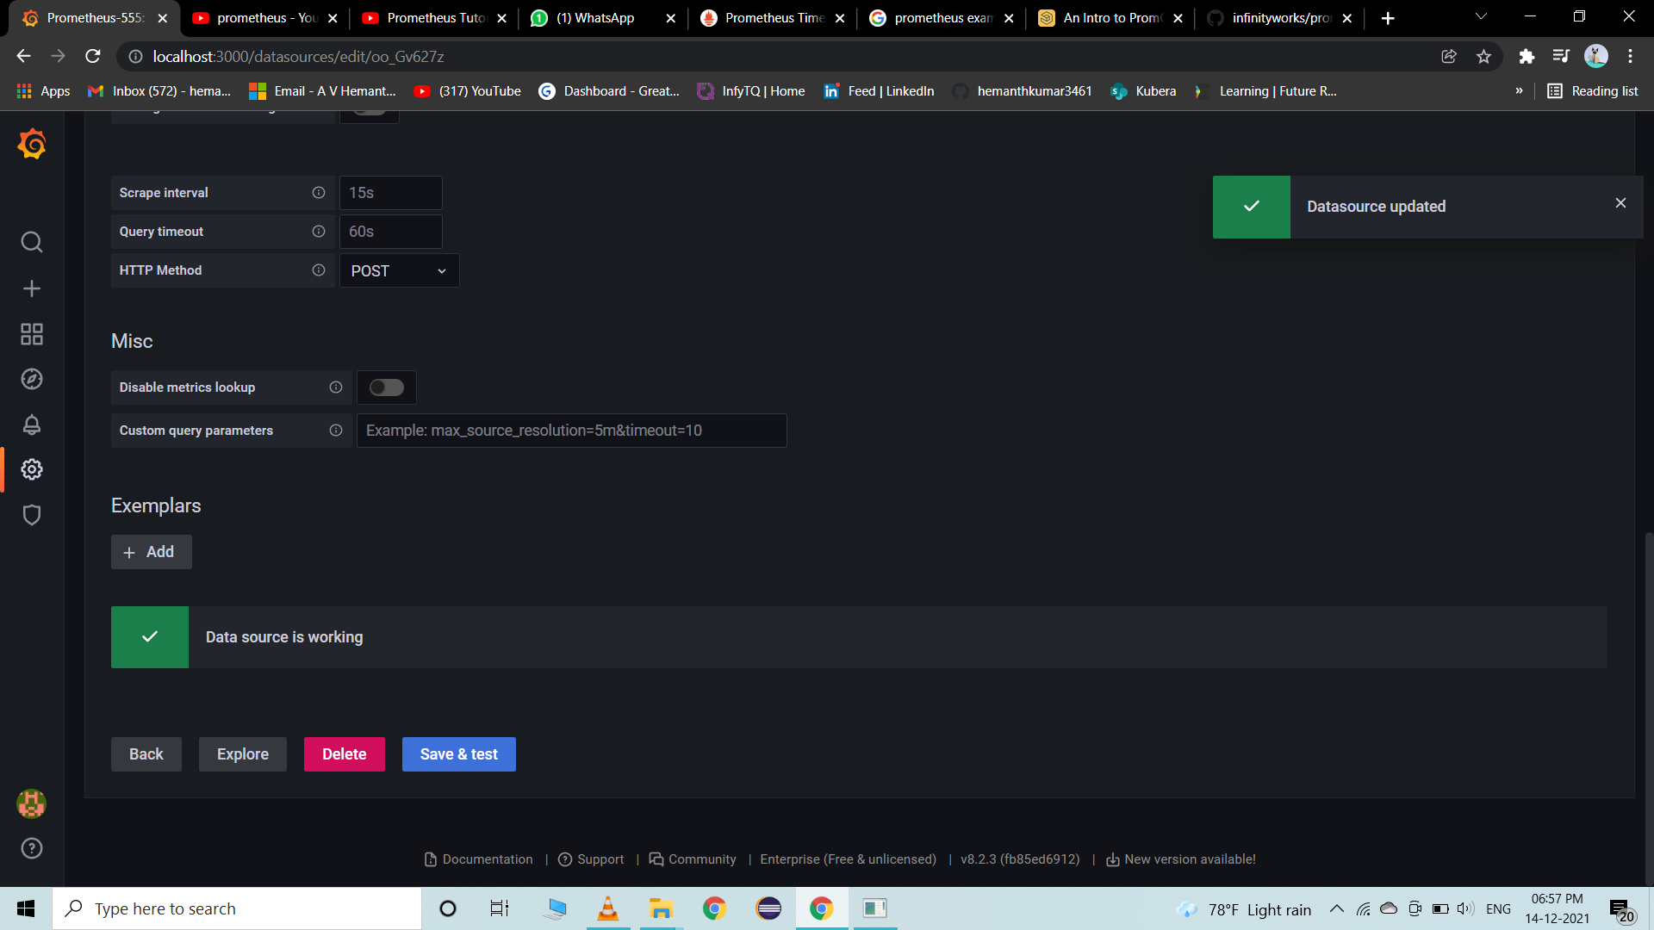
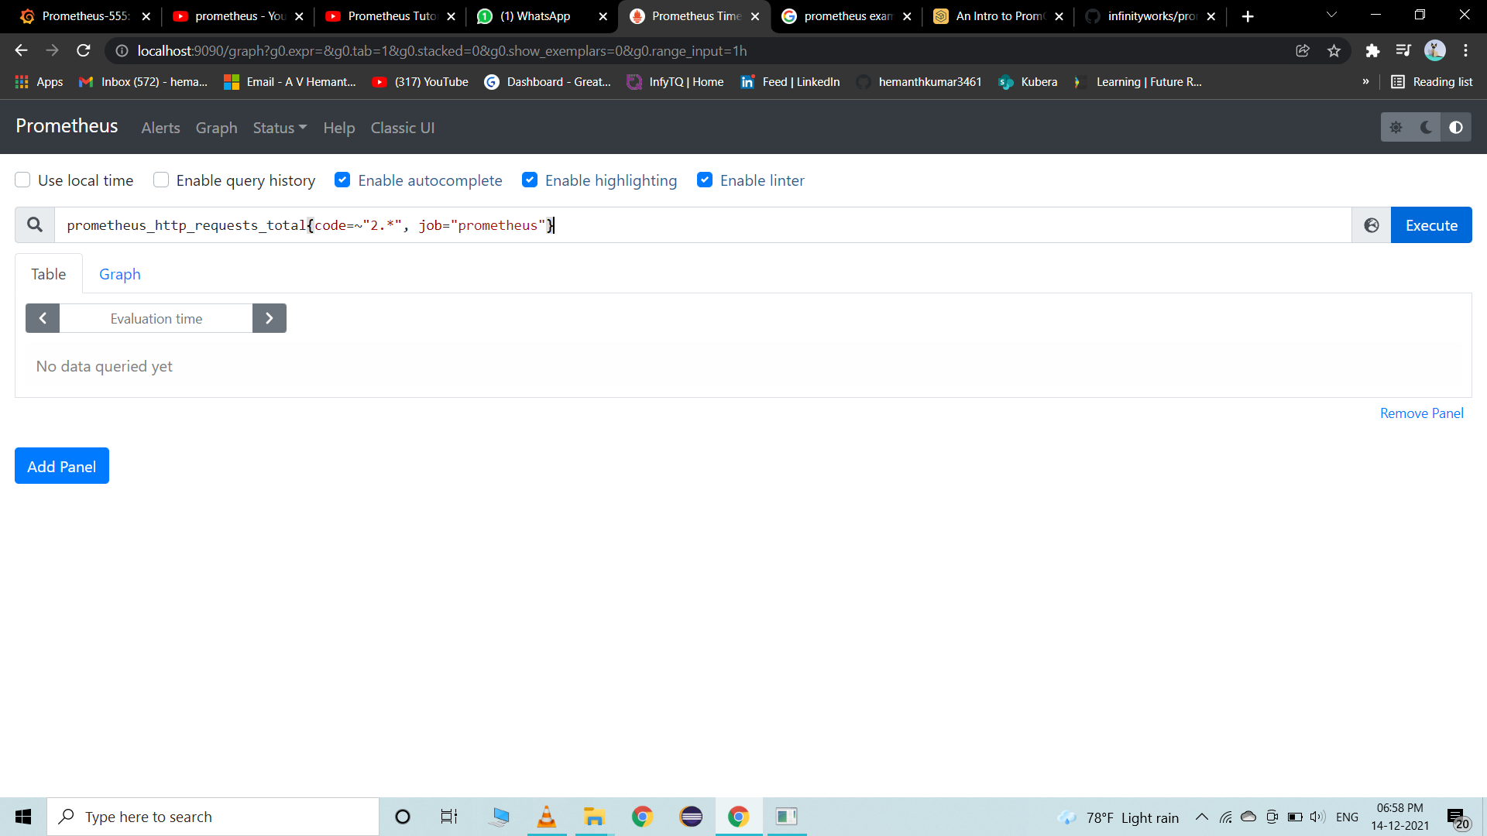
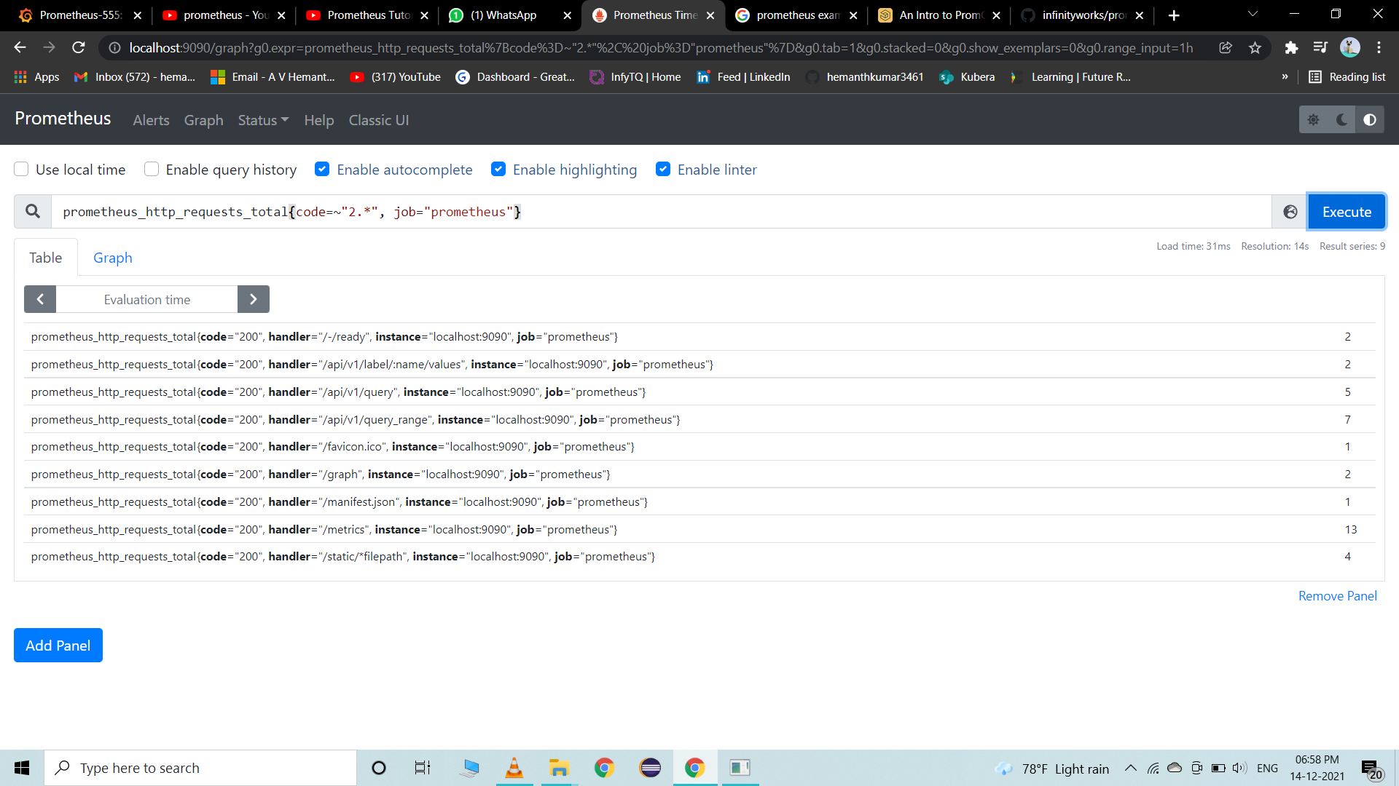

Slide 23
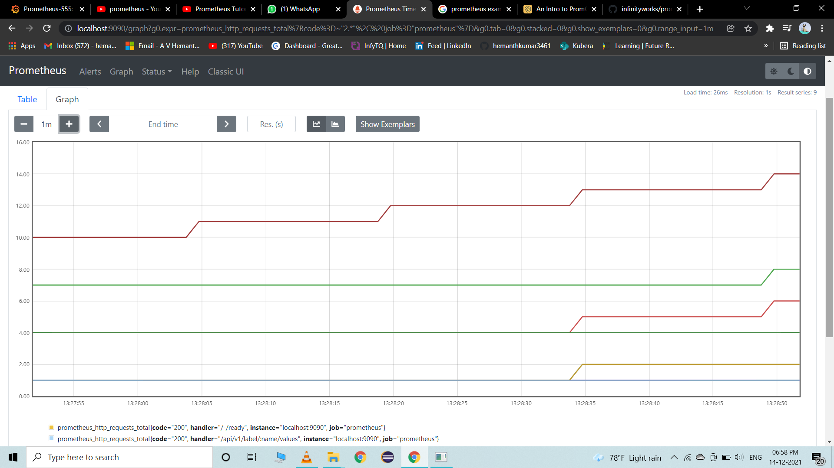
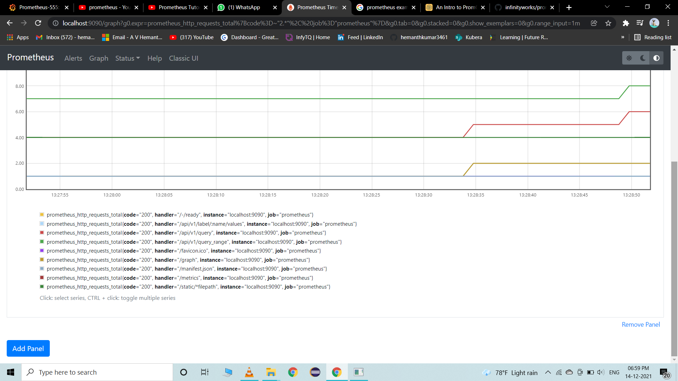

Slide 24
Thank you

